Slide 1
Pacific equatorial circulation and ENSO
Pacific equatorial circulation
(Atlantic, Indian equatorial circulations)
El Niño/Southern Oscillation (ENSO)

Slide 2
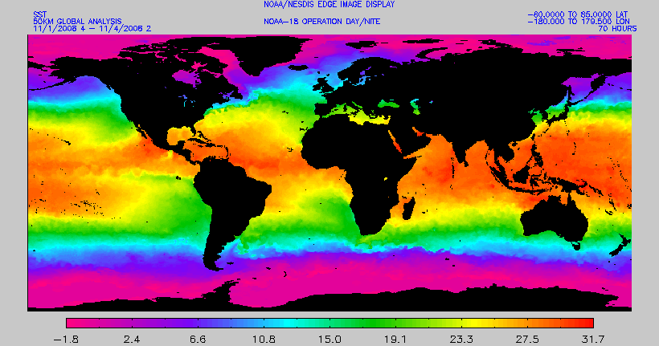
Sea surface temperature (satellite)
Cold tongue (colder water along equator in east)
Warm pool (warmer water along equator in west)
http://www.osdpd.noaa.gov/PSB/EPS/SST/sst_anal_fields.html

Slide 3
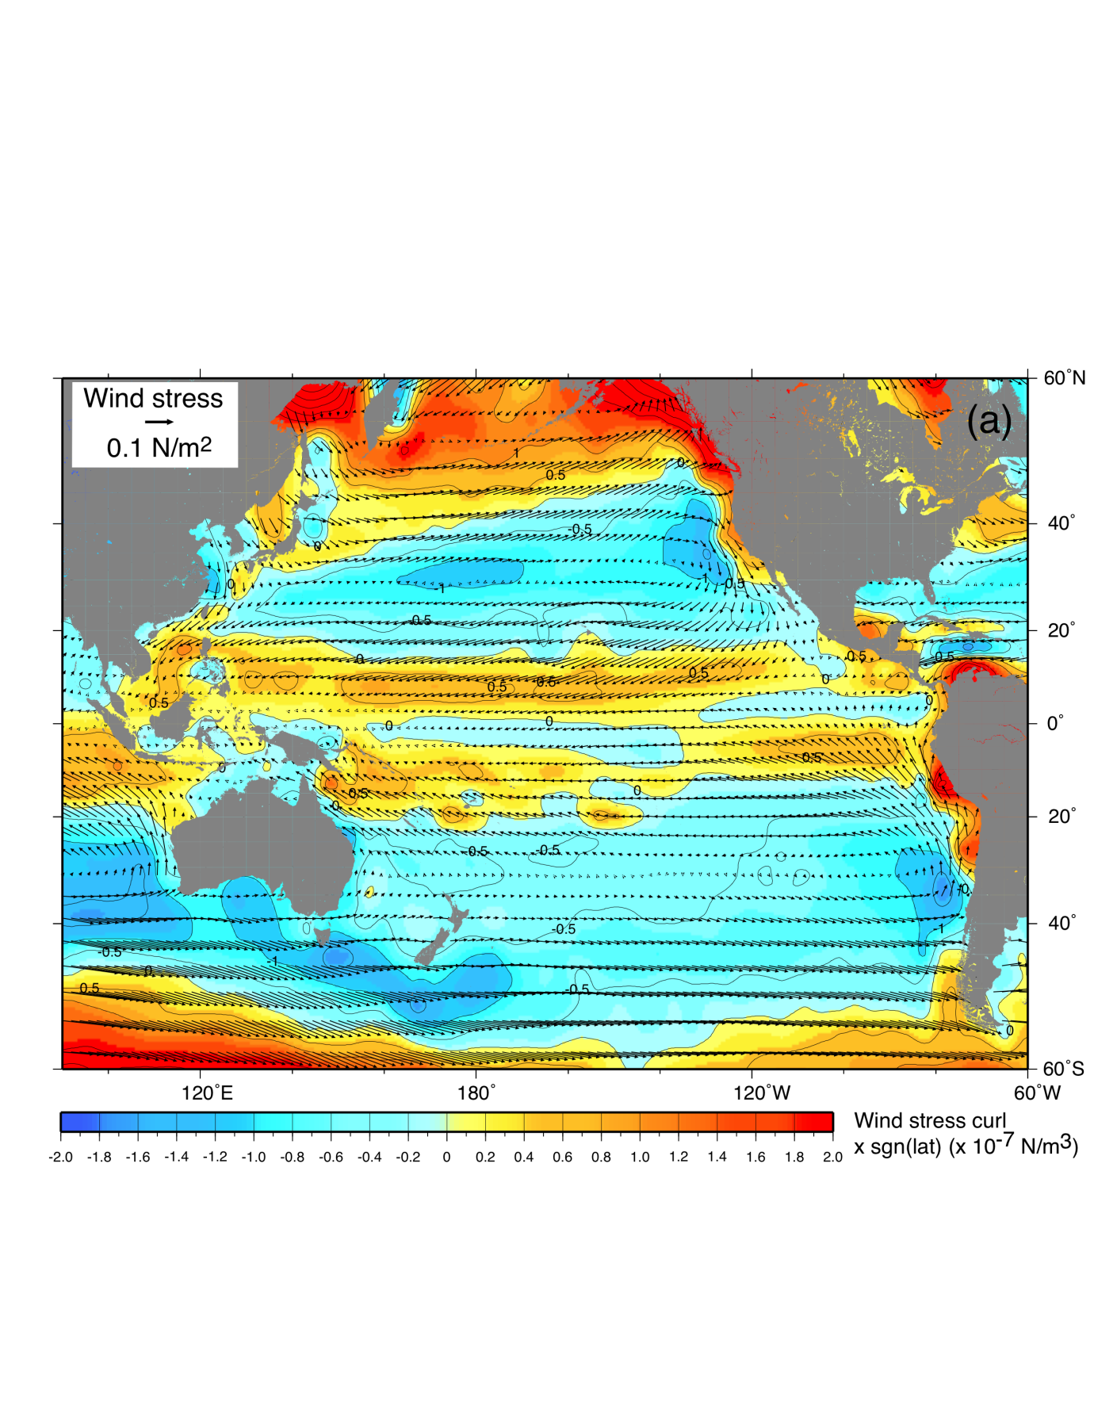
Forcing: Pacific wind stress and wind stress curl
Wind stress (vectors)
Blue: Ekman pumping (downwelling regions)
Yellow-red: Ekman suction (upwelling regions)

Slide 4
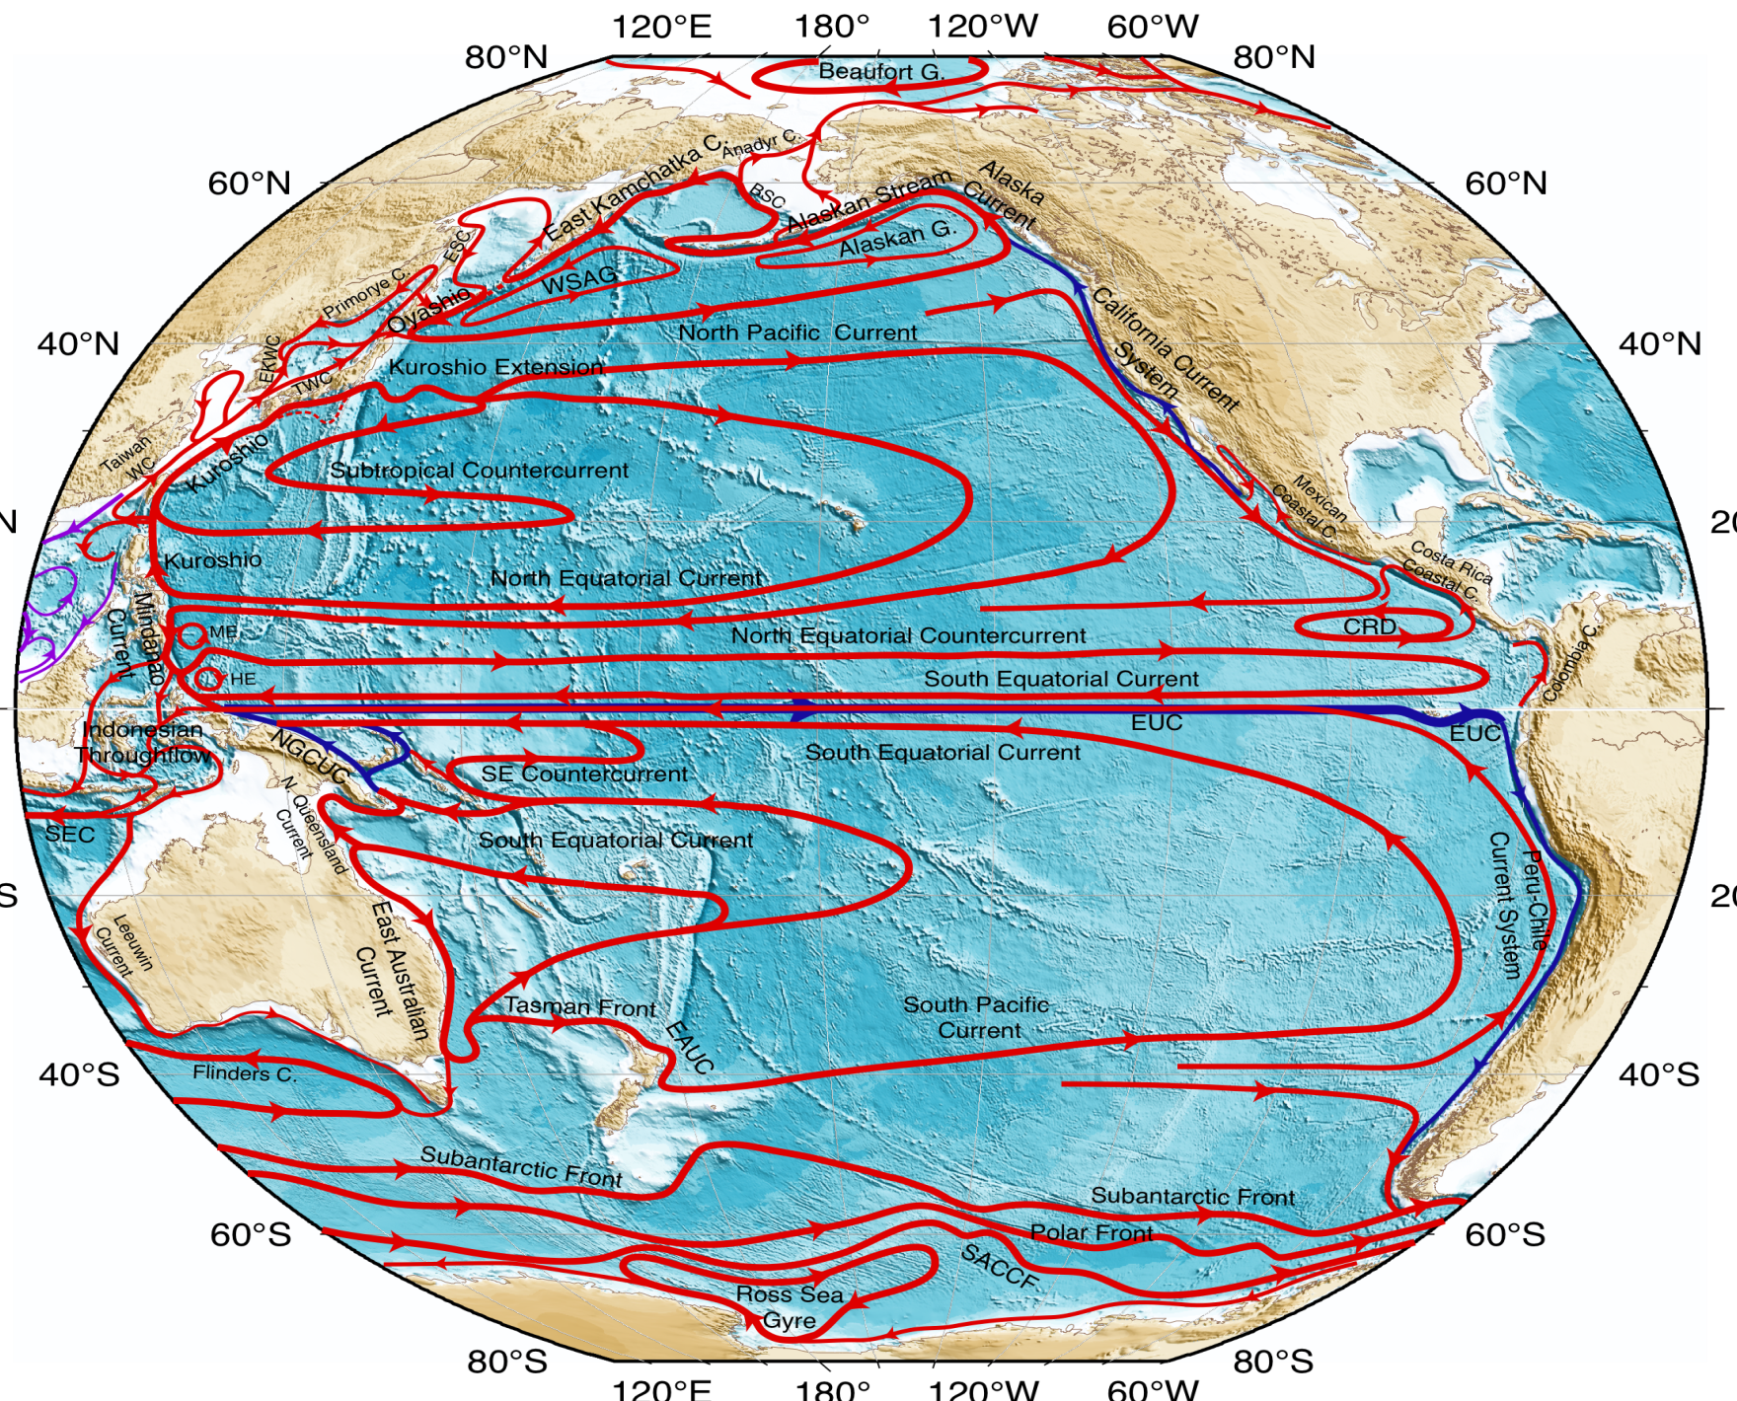
Surface circulation

Slide 5
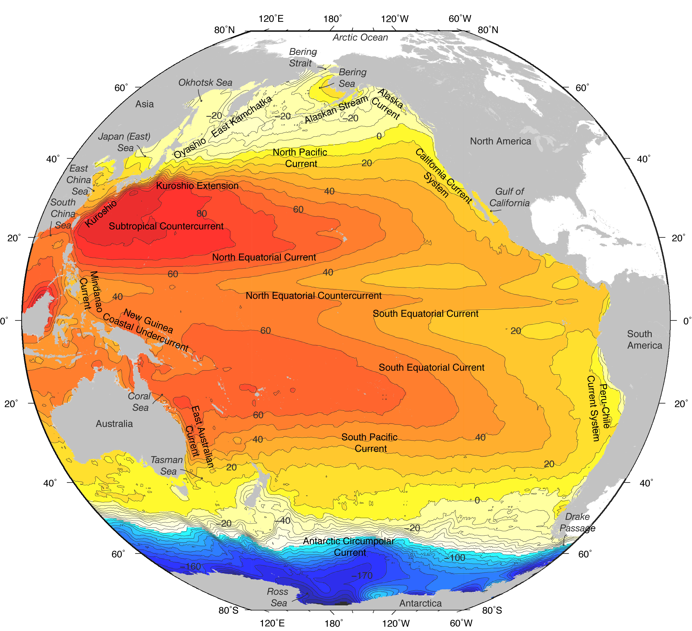
Pacific surface currents

Slide 6

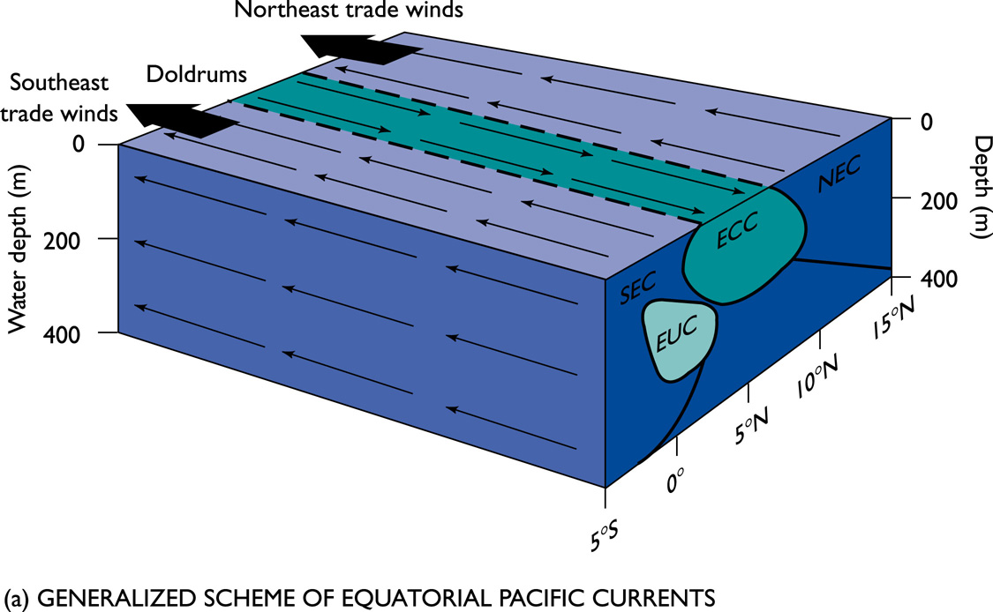
The Northern and Southern Equatorial Currents (SEC and NEC) range from ~10ºN - 20 ºN and ~0 º - 10 º S
They are shallow currents, mostly confined to the well mixed surface layer (~200m)
Velocity ranges between 0.3m/s and 1.0m/s with the SEC being stronger in flow.
Each current transports ~15 Sv

Slide 7
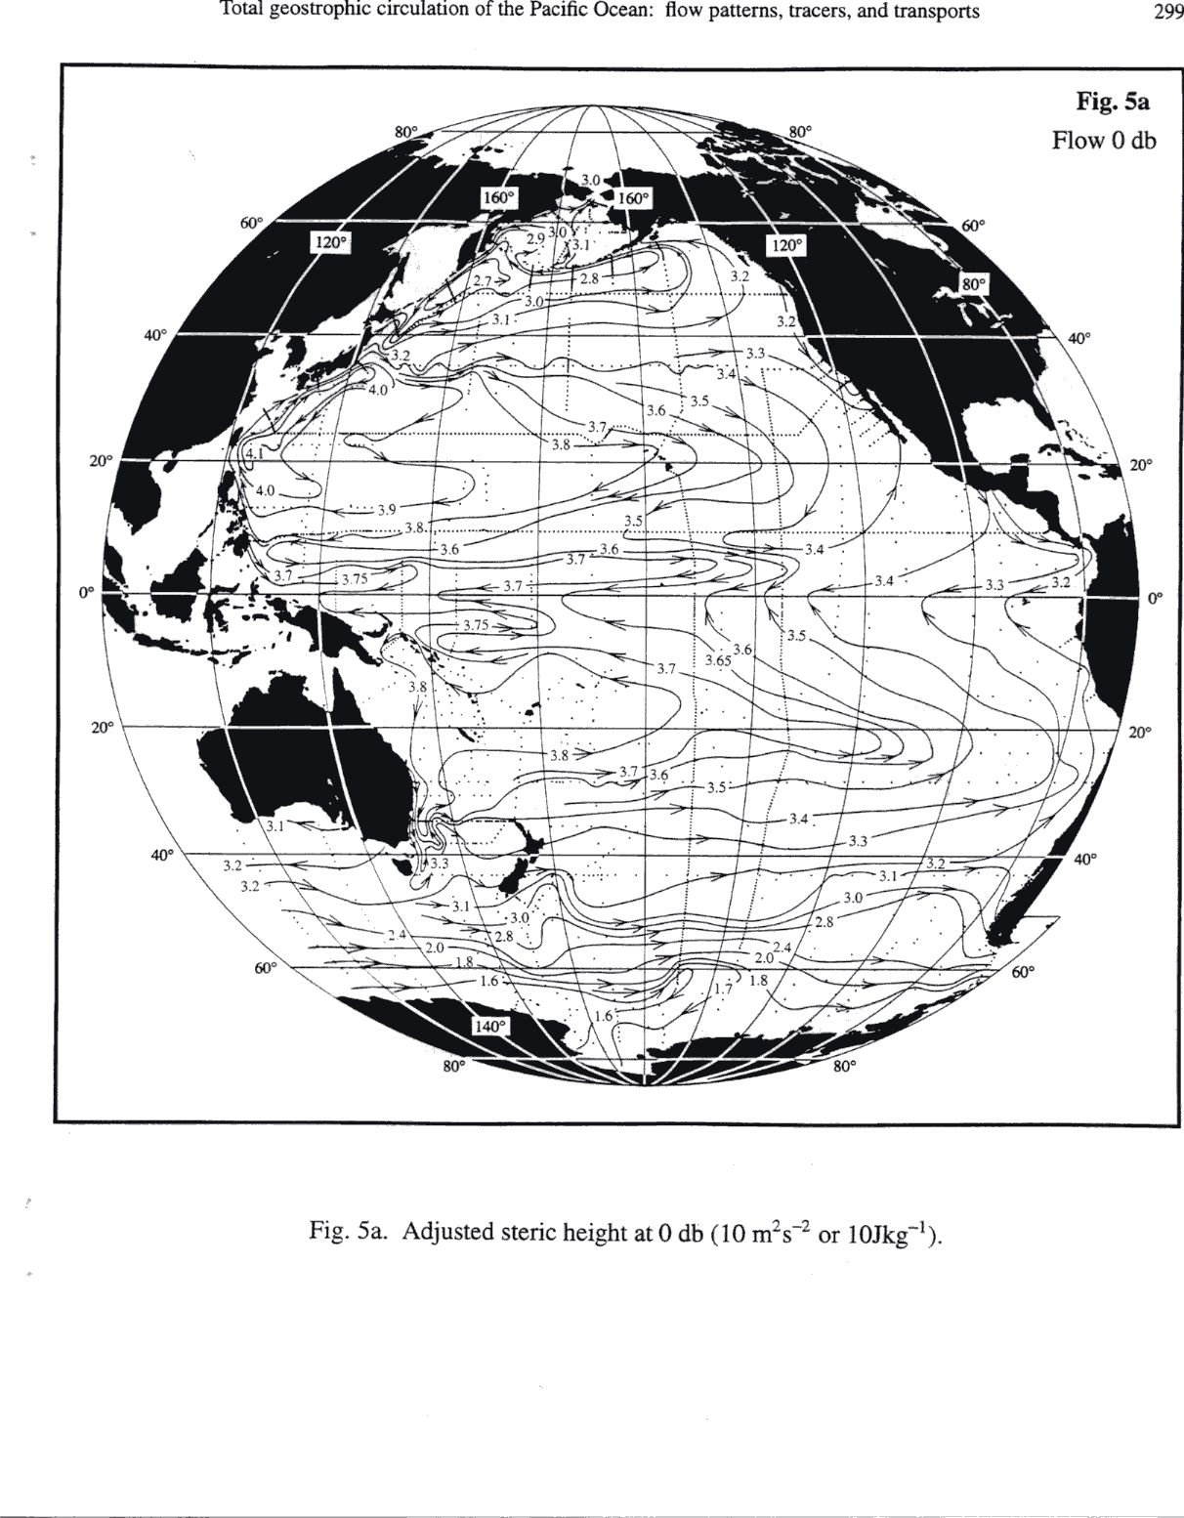
Tropical Pacific surface steric height
North Equatorial Countercurrent (eastward)
North Equatorial Current (westward)
Mindanao Current (western boundary current for the NEC/NECC cyclonic circulation)
South Equatorial Current (westward)
NOTE: The mean surface flow on the equator is westward
Notes:
1. southward interior flow (North Pacific Current is the eastward portion and the North Equatorial Current is the westward portion)
2. northward western boundary current: Kuroshio

Slide 8
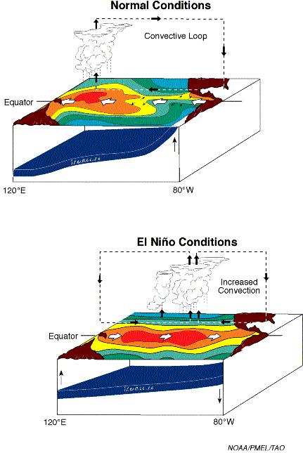
Pacific equatorial structures (upper ocean) (normal conditions)
1. Easterly winds (Walker circulation)
2. Poleward Ekman transport creates meridional pgf: westward geostrophic surface flow NOT at equator
Downwind surface flow on equator due to (1) and westward near equator due to (2)
Equatorial upwelling due to (1) westward flow (cold tongue vs. warm pool) and (2) poleward flow (upwelling at all longitudes)
Warm pool
Cold tongue
(“normal” compared with El Niño conditions)

Slide 9
Pacific equatorial structures (upper ocean) (ENSO)
We refer often today to
“normal”
“El Niño”
“La Niña”
conditions, which alternate irregularly every 3 to 7 years. This is natural climate variability (interannual).
El Niño is a warm equatorial phase.
La Niña is similar to normal, but more extreme.
Warm pool
Cold tongue

Slide 10
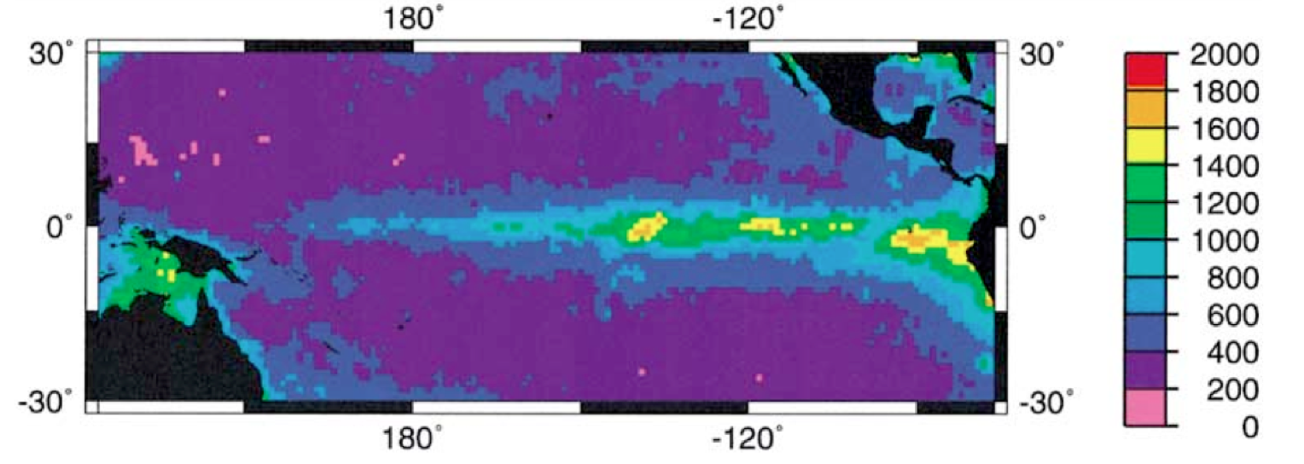
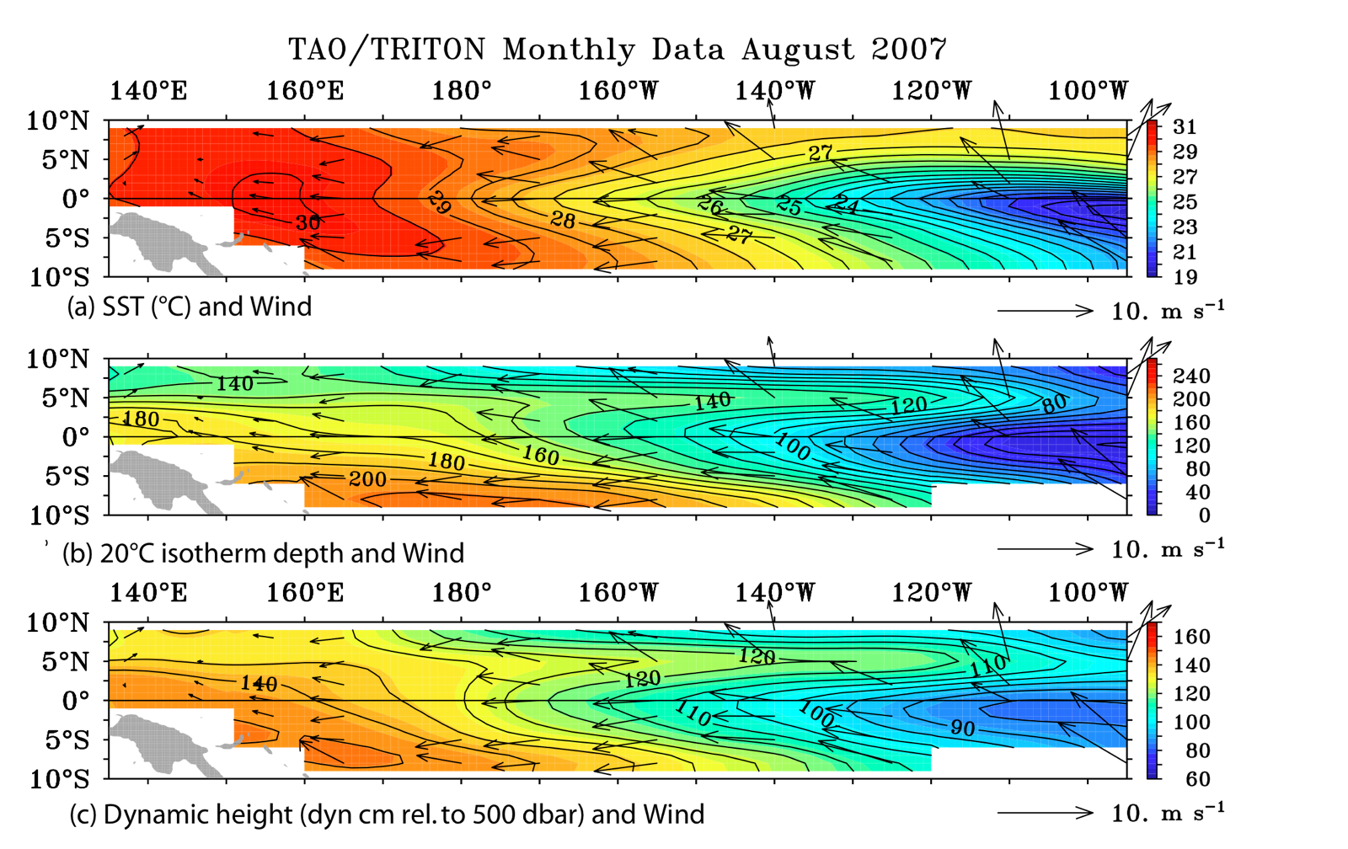
Normal equatorial conditions
Trade winds
Cold tongue
Thermocline deep in west, shallow in east
Dyn. Ht. and SSH high in west, low in east
High productivity (ocean color) in cold tongue
La Niña phase is very similar
DPO Fig. 10.22

Slide 11
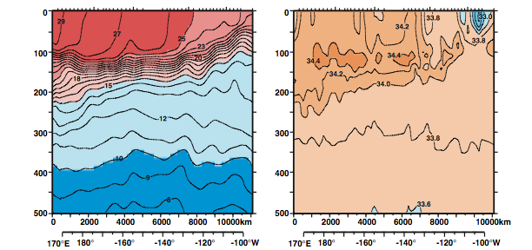
Along-equatorial (zonal) temperature and salinity sections: Pacific
Thick warm layer in west (warm pool)
Thermocline surfaces to east, cooler water at surface (cold tongue)
“Alize” cruise (France, 1991)

Slide 12
Upwelling 1: caused by downwind VISCOUS westward flow along the equator (one part of the South Equatorial Current), due to the easterly Trade Winds, creating upwelling in the east at the continent (S. America) and piling up in the west at the land (Indonesia)
Upwelling creates the Cold Tongue in the eastern equatorial region. Pileup of warm water creates the Warm Pool in the western equatorial region. (Both are SST features; Cold Tongue accompanied by shallow thermocline, Warm Pool by deeper thermocline)
The equatorial surface flow causes high pressure (high sea level) in the west and low pressure (low sea level) in the east, therefore an eastward PGF.
Upwelling 2: caused by off-equatorial Ekman transport driven by the easterly Trade Winds

Slide 13
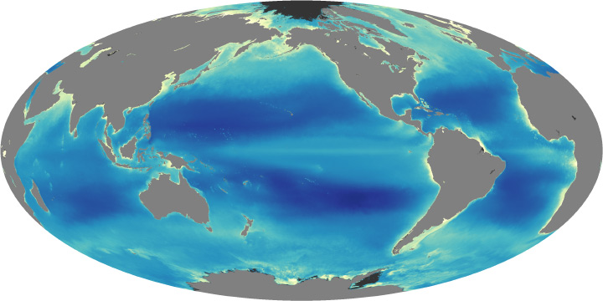
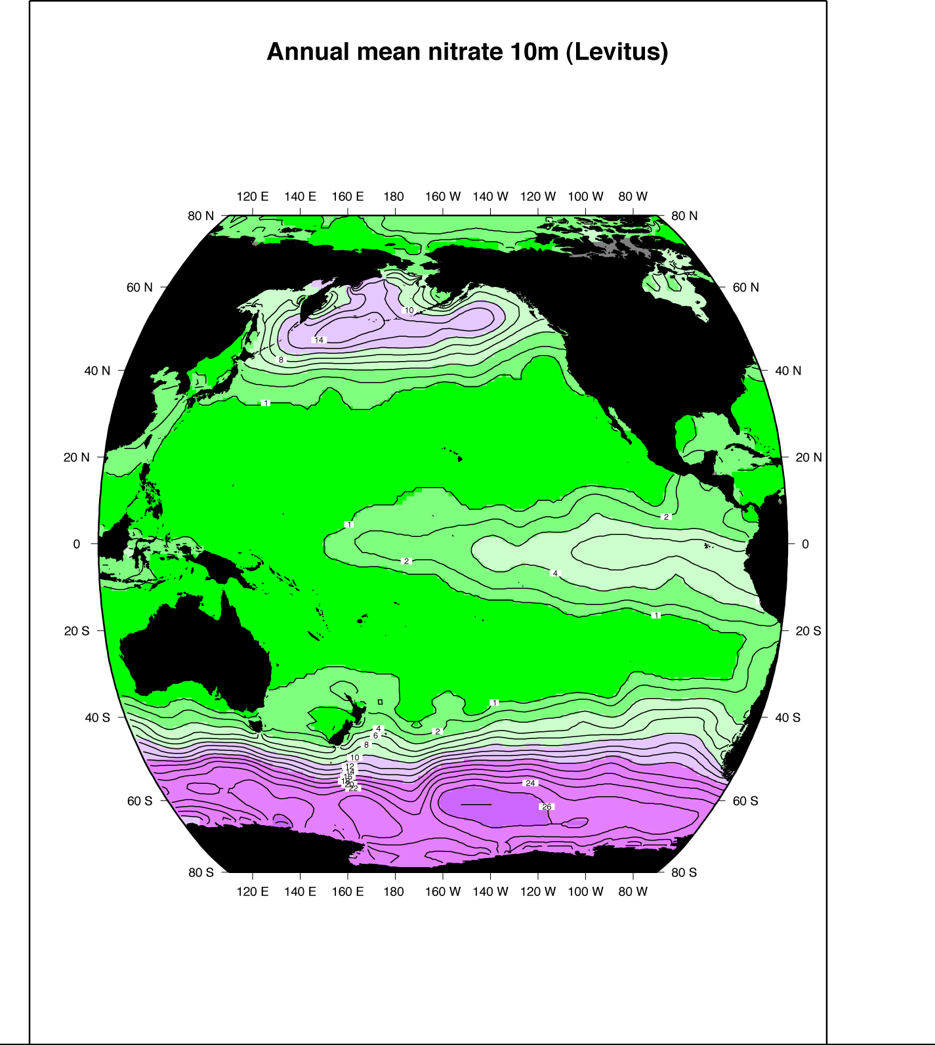
Ekman-induced upwelling/downwelling, effect on surface nutrients
Ocean color: chlorophyll Nitrate at 10 m depth
http://earthobservatory.nasa.gov/Features/Phytoplankton/page4.php
Equatorial upwelling brings nutrients to sea surface, enhanced in cold tongue in the mean

Slide 14
Down-gradient flow driven by the equatorial PGF: causes eastward flow along the equator. This is called the Equatorial Undercurrent. The strongest current in the global ocean > 150 cm/sec, but very thin and restricted to very close to the equator.
Geostrophic flow driven by the cross-equatorial PGF (which results from the low sea level along the equator due to off-equatorial transport driven by the winds). This geostrophic flow is westward in both hemispheres: South Equatorial Current (off-equatorial portion, in BOTH hemispheres – confusing nomenclature)

Slide 15
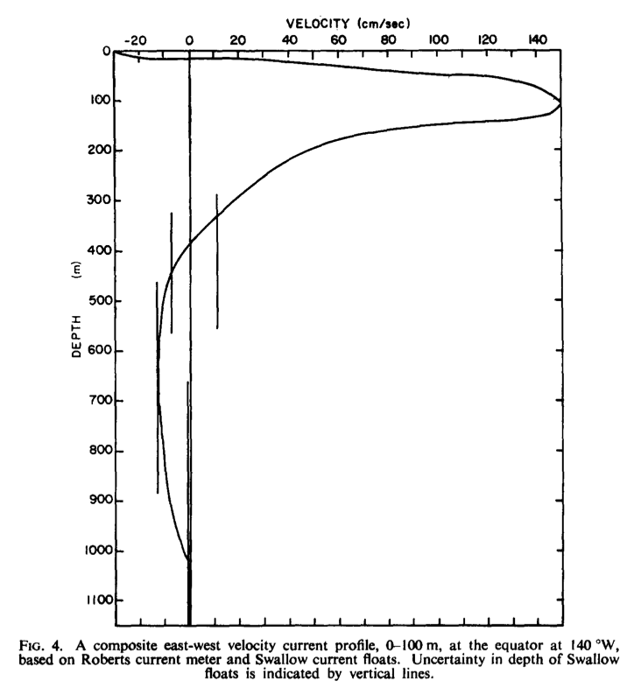
Equatorial Undercurrent
Just beneath the surface westward flow (SEC), there is a powerful eastward undercurrent, called Equatorial Undercurrent (EUC).
Beneath the EUC there is a weak westward flow called the Equatorial Intermediate Current
(Knauss, DSR 1960)
Notes:
Got to here

Slide 16
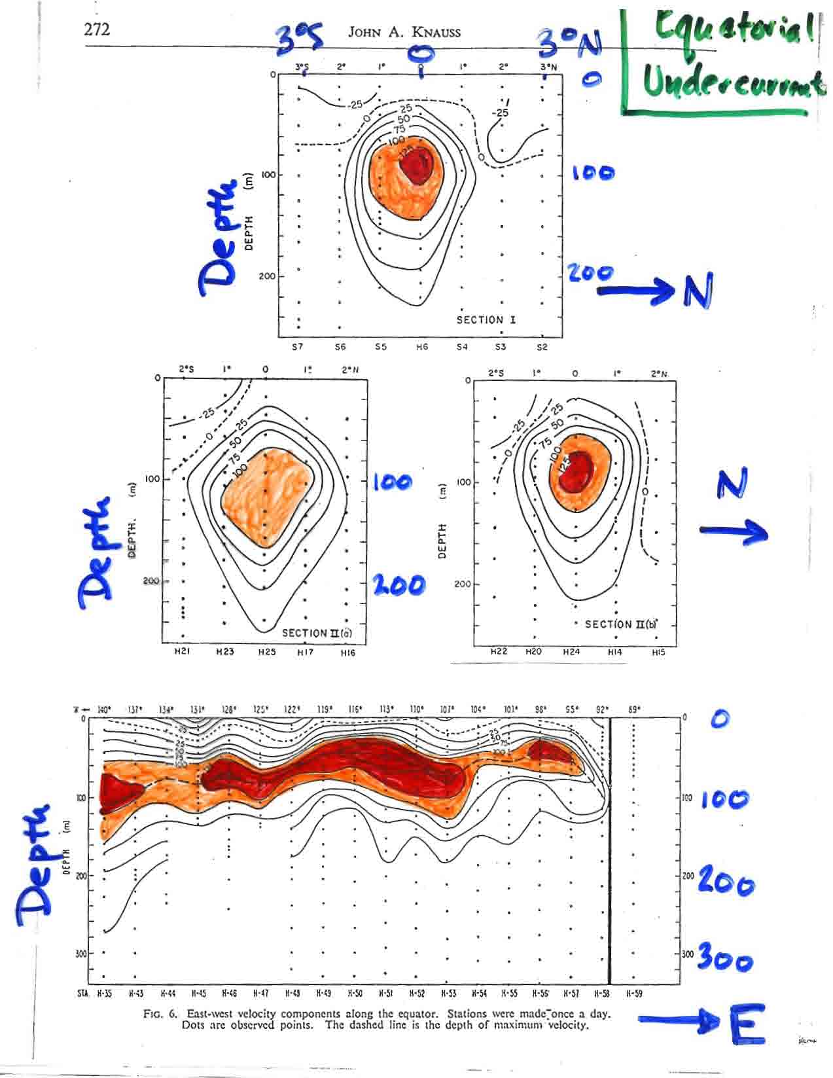
Equatorial Undercurrent
Velocity sections across equator showing equatorial undercurrent
Also structure along the equator, suggesting shoaling in the east.
(Knauss, 1960)

Slide 17
Dynamics IX: Equatorial dynamics in brief (slide 4): tropical geostrophic flows associated with wind stress curl and Sverdrup transport
More than 1° latitude or so from the equator, the circulation reverts to the Sverdrup transport concept. This is geostrophic flow, which is forced through potential vorticity changes resulting from Ekman downwelling or upwelling
Southern Hemisphere: Ekman downwelling throughout tropics into the subtropics, hence westward flow. This is yet another part of the South Equatorial Current
Northern Hemisphere: Band of Ekman upwelling beneath the ITCZ causes a very wide (longitude), very narrow (latitude) cyclonic gyre, with eastward flow (North Equatorial Countercurrent) on its south side and westward flow on its north side (North Equatorial Current).

Slide 18
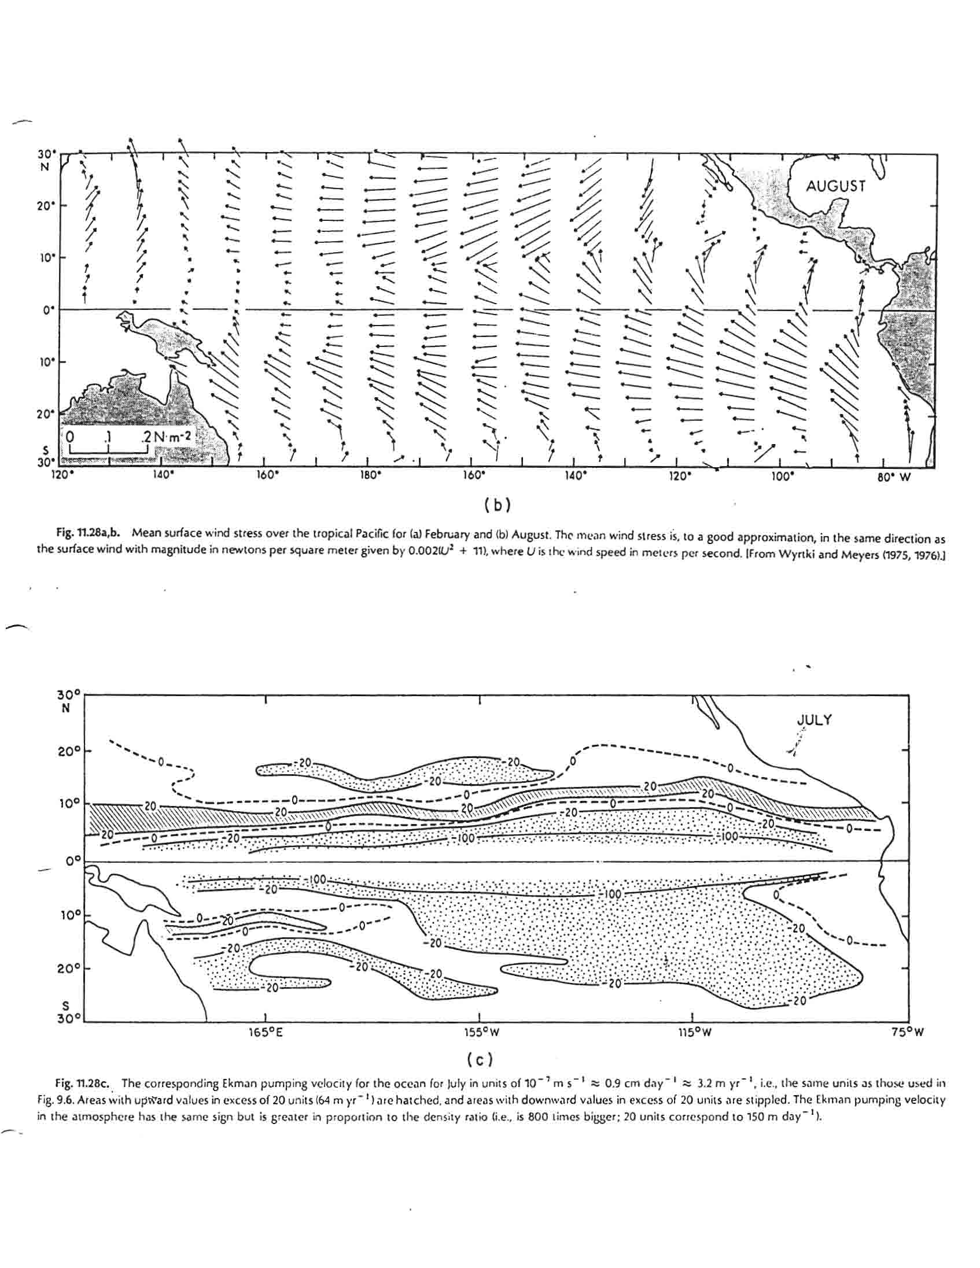
Tropical winds and Ekman pumping
Gill (1982)
Trade winds, convergence at 5-10°N (ITCZ)
Elongated Ekman suction region, creating the NECC, Mindanao Current cyclonic “gyre”

Slide 19
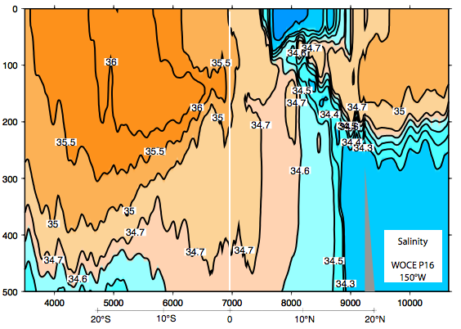
Pacific meridional salinity section crossing equator
Surface fresh band under the ITCZ
High salinity in subtropics, equatorward salinity maximum (“Subtropical Underwater”)
S. Pacific is saltier than N. Pacific
WOCE P16 (Talley, 2007)
Notes:
1. southward interior flow (North Pacific Current is the eastward portion and the North Equatorial Current is the westward portion)
2. northward western boundary current: Kuroshio

